Slide 1

Computer Networks
Application Layer – TCP/IP Model
Lecture # 03

Slide 2
TCP/IP Protocol Suite
The layers in the TCP/IP protocol suite do not exactly match those in the OSI model.
The original TCP/IP protocol suite was defined as having four layers: host-to-network, internet, transport, and application.
However, when TCP/IP is compared to OSI, we can say that the TCP/IP protocol suite is made of five layers:
physical,
data link,
network,
transport, and
application.

Slide 3
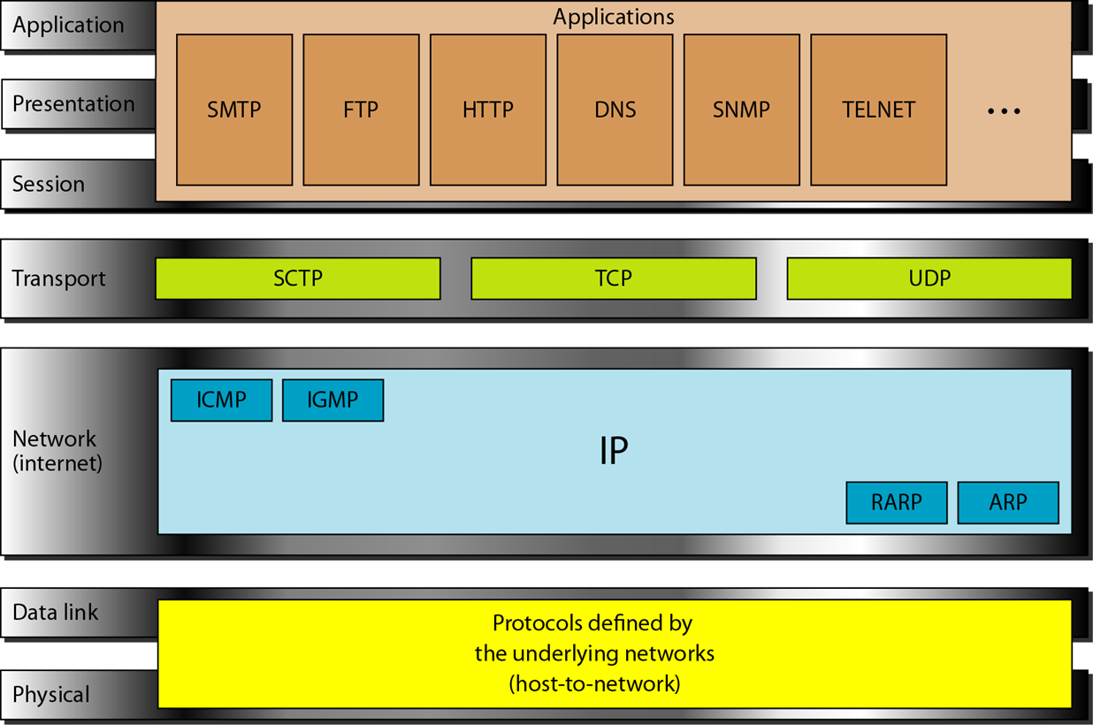

Slide 4
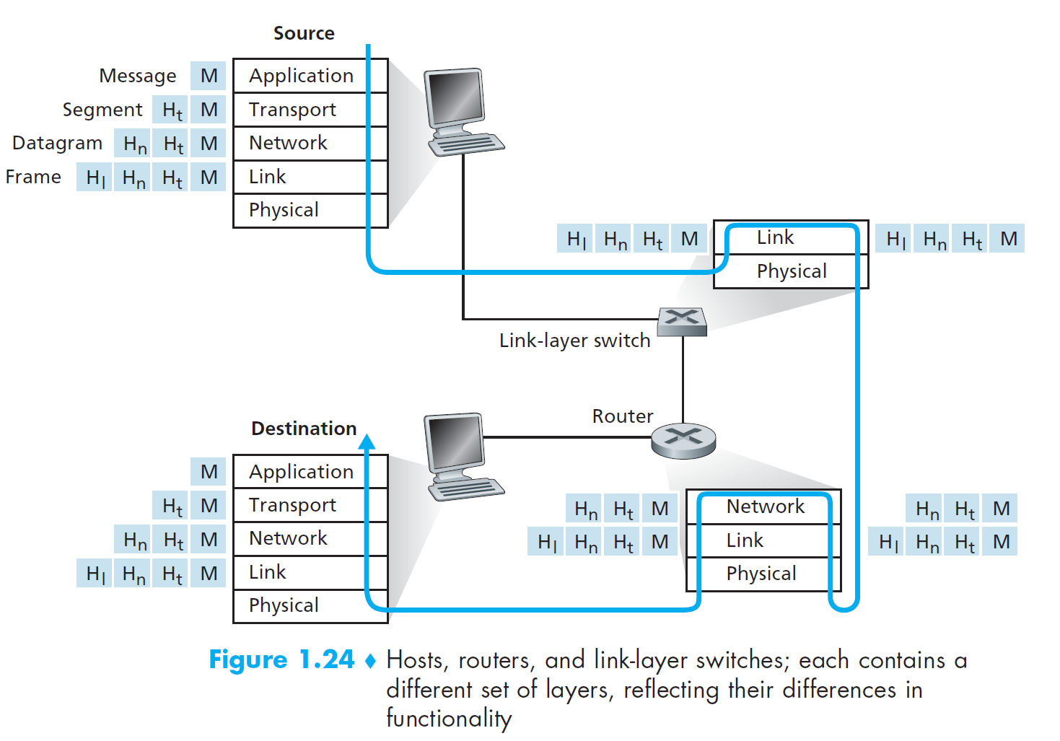

Slide 5
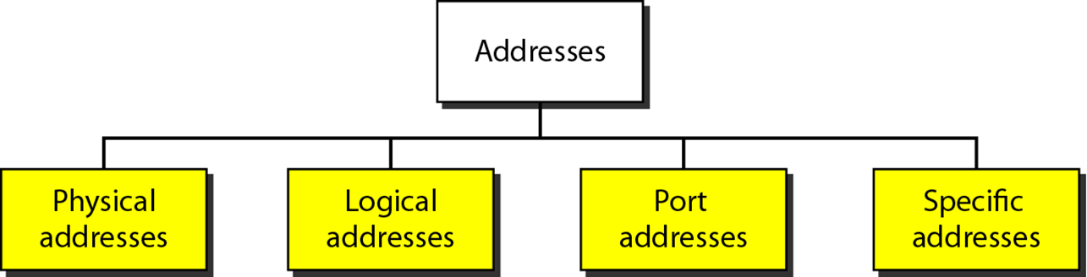
Addressing
Four levels of addresses are used in an internet employing the TCP/IP protocols:
physical (link) addresses,
logical (IP) addresses,
port addresses, and
specific addresses

Slide 6
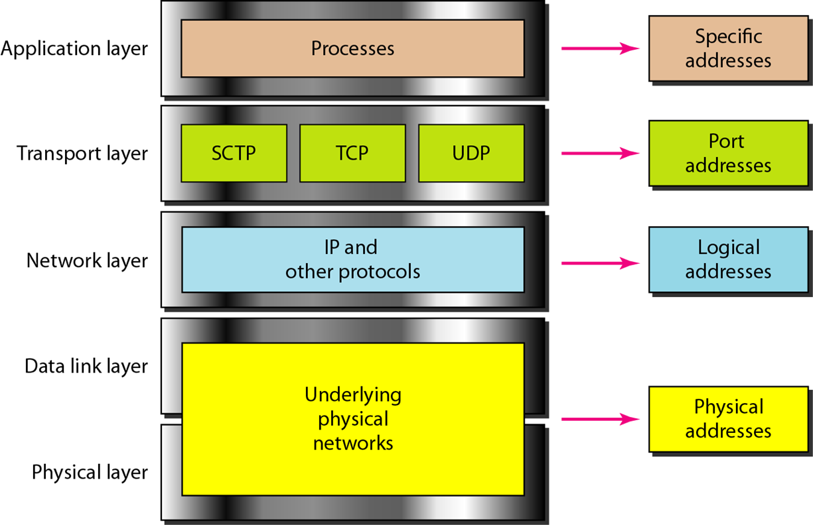
Notes:
Logical Address= IP Address
Physical Address= MAC address

Slide 7
Application Layer
The conceptual and implementation aspects of network applications.
Key application-layer concepts, including
network services required by applications,
clients and servers,
processes, and
transport-layer interfaces.
Several network applications in detail, including the Web, e-mail, DNS, and peer-to-peer (P2P) file distribution, multimedia applications, including streaming video and VoIP.
Network application development, over both TCP and UDP. In-particular, the socket API and walk through some simple client-server applications

Slide 8
Layer 7 – Application Layer
The application layer enables the user, whether human or software, to access the network.
It provides user interfaces and support for services such as electronic mail, remote file access and transfer, shared database management, and other types of distributed information services.
The application layer is responsible for providing services to the user.

Slide 9
Network virtual terminal: A network virtual terminal is a software version of a physical terminal, and it allows a user to log on to a remote host. To do so, the application creates a software emulation of a terminal at the remote host. The user's computer talks to the software terminal which, in turn, talks to the host, and vice versa. The remote host believes it is communicating with one of its own terminals and allows the user to log on.
File transfer, access, and management: This application allows a user to access files in a remote host (to make changes or read data), to retrieve files from a remote computer for use in the local computer, and to manage or control files in a remote computer locally.
Mail services: This application provides the basis for e-mail forwarding and storage.
Directory services: This application provides distributed database sources and access for global information about various objects and services.

Slide 11
Network Applications
Program Running on end systems.
No concern with underlying networks
Software written in C, Java, Python etc running on multiple end devices.
For example:
in the Web application there are two distinct programs that communicate with each other: the browser program running in the user’s host (desktop, laptop, tablet, smartphone, and so on); and the Web server program running in the Web server host.
As another example, in a P2P file-sharing system there is a program in each host that participates in the file-sharing community. In this case, the programs in the various hosts may be similar or identical.

Slide 12
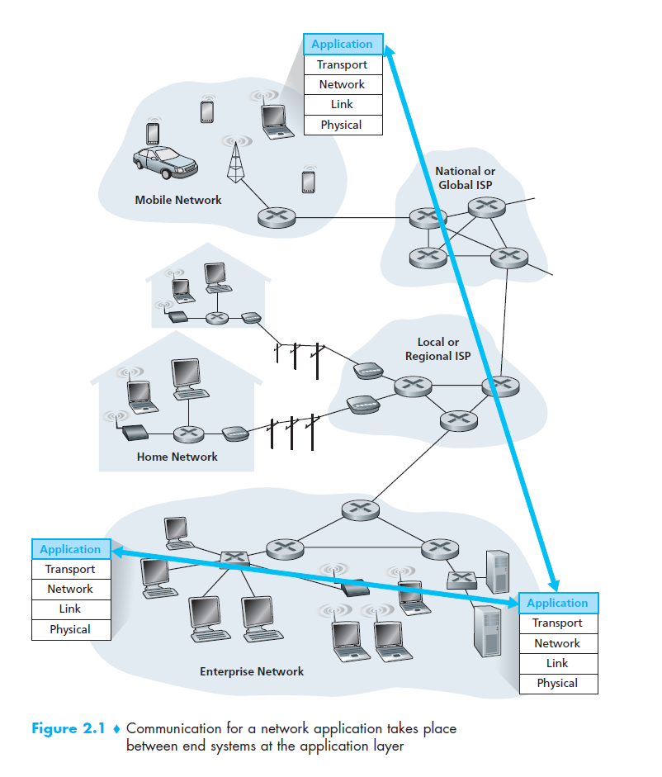

Slide 13
Network Application Architecture
Two predominant architectural paradigms used in modern network applications:
The client-server architecture or
The peer-to-peer (P2P) architecture

Slide 14
Client-Server Architecture
In a client-server architecture,
There is an always-on host, called the server, which services requests from many other hosts, called clients.
Another characteristic is that the server has a fixed, well-known address, called an IP address.
Popular social-networking site can quickly become overwhelmed if it has only one server handling all of its requests. For this reason, a data center, housing a large number of hosts, is often used to create a powerful virtual server e.g. Google, Amazon, Facebook etc
Examples: Web, FTP, Telnet, and e-mail are client-server.
Notes:
Google has 30 to 50 data centers distributed around the world, which collectively handle search, YouTube, Gmail, and other services. A data center can have hundreds of thousands of servers, which must be powered and maintained. Additionally, the service providers must pay recurring interconnection and bandwidth costs for sending data from their data centers.

Slide 15
Peer-to-Peer P2P Architecture
Minimal (or no) reliance on dedicated servers in data centers.
Application exploits direct communication between pairs of intermittently connected hosts, called peers.
The peers are not owned by the service provider.
Self scalabale.
Many of today’s most popular and traffic-intensive applications are based on P2P architectures.
These applications include file sharing (e.g., BitTorrent), peer-assisted download acceleration (e.g., Xunlei), Internet Telephony (e.g., Skype), and IPTV (e.g., Kankan and PPstream)
Notes:
In a P2P architecture, there is minimal (or no) reliance on dedicated servers in
data centers. Instead the application exploits direct communication between pairs of
intermittently connected hosts, called peers. The peers are not owned by the service
provider, but are instead desktops and laptops controlled by users, with most of the
peers residing in homes, universities, and offices. Because the peers communicate
without passing through a dedicated server, the architecture is called peer-to-peer.
Many of today’s most popular and traffic-intensive applications are based on P2P
architectures. These applications include file sharing (e.g., BitTorrent), peer-assisted

Slide 16
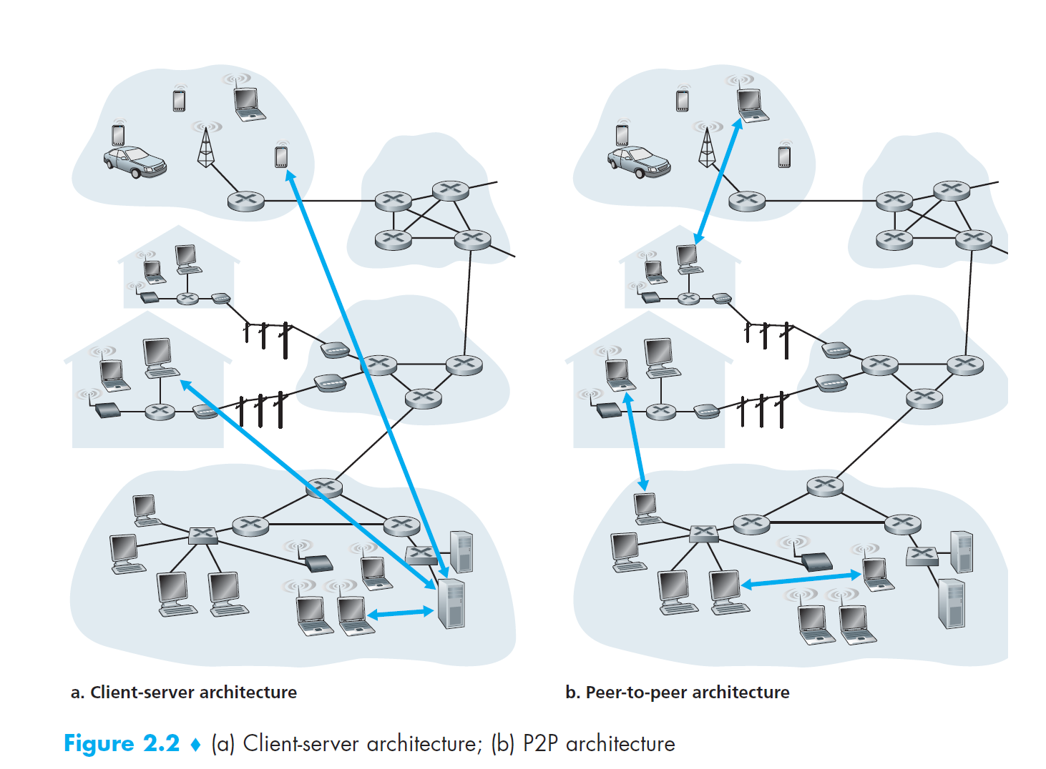

Slide 17
Hybrid Architecture
Some applications have hybrid architectures, combining both client-server and P2P elements.
For example, for many instant messaging applications, servers are used to track the IP addresses of users, but user-to-user messages are sent directly between user hosts (without passing through intermediate servers).
Notes:
IPFS, Bitmessage

Slide 18
P2P Chalanges
However, future P2P applications face three major challenges:
ISP Friendly: Most residential ISPs (including DSL and cable ISPs) have been dimensioned for “asymmetrical” bandwidth usage, that is, for much more downstream than upstream traffic. But P2P video streaming and file distribution applications shift upstream traffic from servers to residential ISPs, thereby putting significant stress on the ISPs. Future P2P applications need to be designed so that they are friendly to ISPs
Security: Because of their highly distributed and open nature, P2P applications can be a challenge to secure
Incentives: The success of future P2P applications also depends on convincing users to volunteer bandwidth, storage, and computation resources to the applications, which is the challenge of incentive design

Slide 19
In the context of a communication session between a pair of processes, the process that initiates the communication (that is, initially contacts the other process at the beginning of the session) is labeled as the client. The process that waits to be contacted to begin the session is the server.

Slide 20
Sockets
Most applications consist of pairs of communicating processes, with the two processes in each pair sending messages to each other. Any message sent from one process to another must go through the underlying network.
A process sends messages into, and receives messages from, the network through a software interface called a socket.
A socket is the interface between the application layer and the transport layer within a host. It is also referred to as the Application Programming Interface (API) between the application and the network, since the socket is the programming interface with which network applications are built.
The application developer has control of everything on the application-layer side of the socket but has little control of the transport-layer side of the socket.
The only control that the application developer has on the transport-layer side is (1) the choice of transport protocol and (2) perhaps the ability to fix a few transport-layer parameters such as maximum buffer and maximum segment sizes.
Notes:
Aprocess is analogous to a house and its socket is analogous to its door.

Slide 21
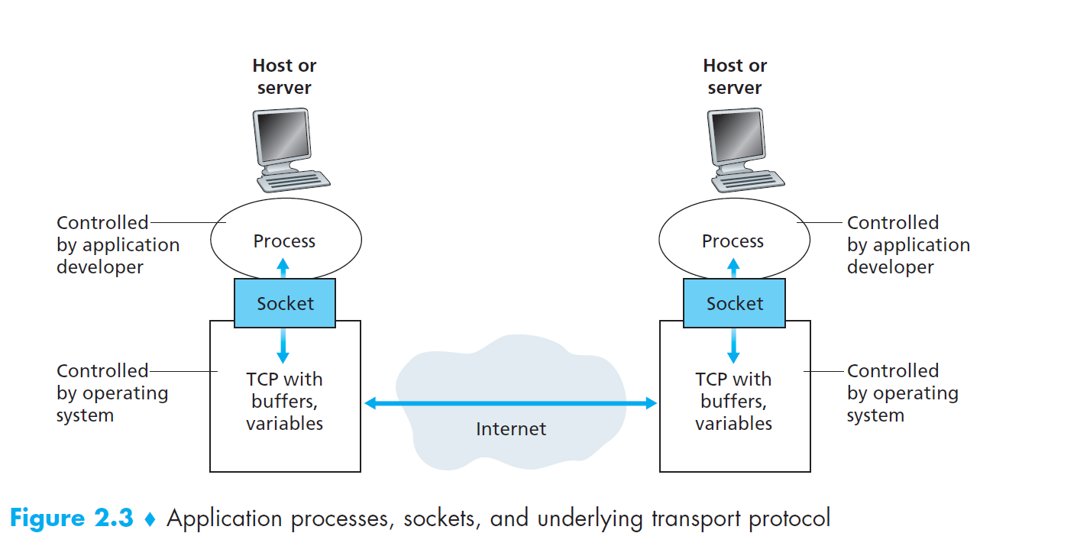

Slide 22
Process Address
Similarly, in order for a process running on one host to send packets to a process running on another host, the receiving process needs to have an address.
To identify the receiving process, two pieces of information need to be specified:
The address of the host and
An identifier that specifies the receiving process in the destination host.

Slide 23
Services provided to the application
Reliable data transfer by transport layer.
Loss tolerant applications – multimedia applications
Bandwidth sensitive applications – multimedia applications
Elastic applications - Electronic mail, file transfer, and Web transfers
Security – Confidentiality, data integrity and end point authentication.
Notes:
Applications that have throughput
requirements are said to be bandwidth-sensitive applications. Many current
multimedia applications are bandwidth sensitive, although some multimedia
applications may use adaptive coding techniques to encode digitized voice or
video at a rate that matches the currently available throughput.

Slide 24
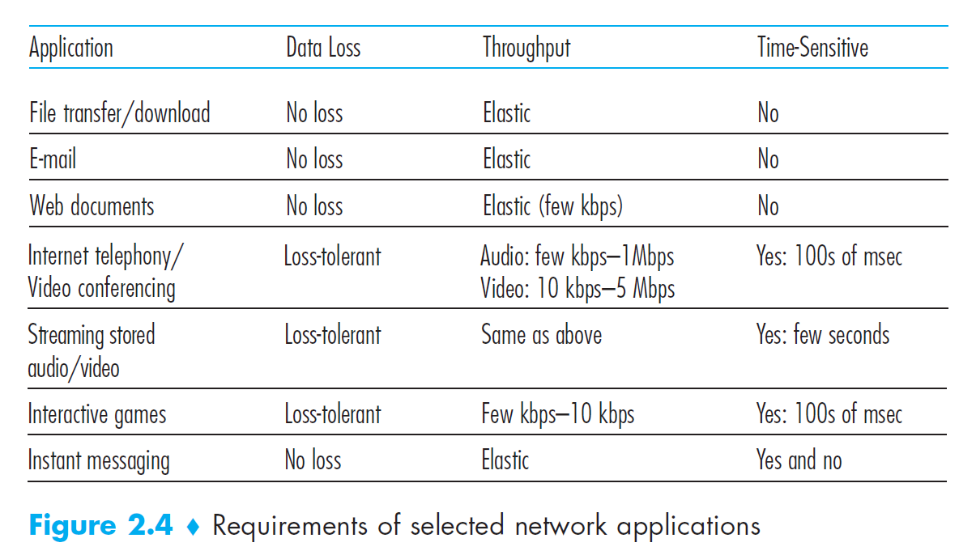

Slide 25
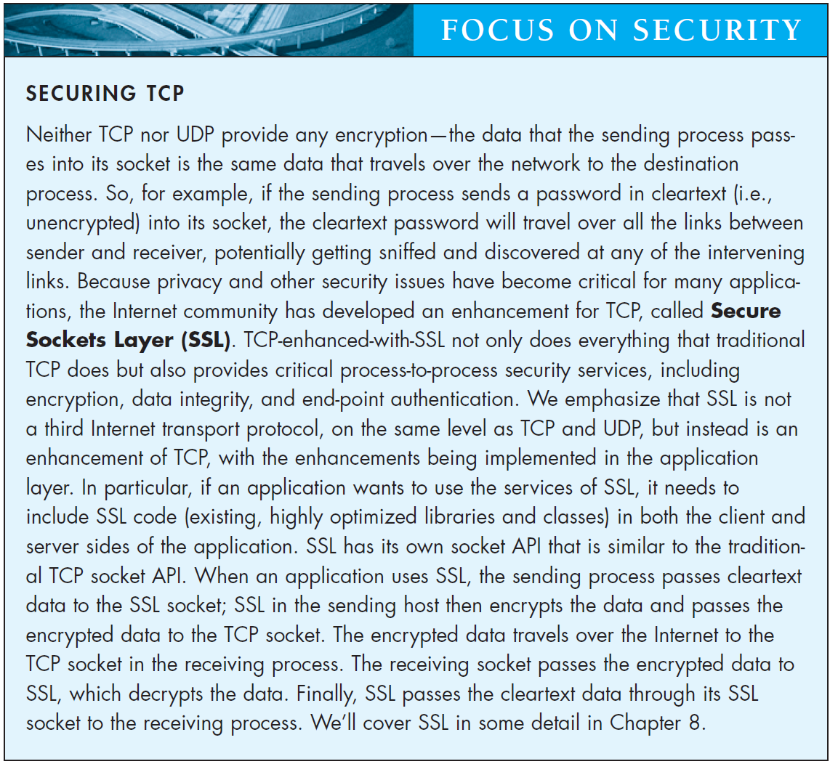

Slide 26
Application Layer Protocols
An application-layer protocol defines how an application’s processes, running on different end systems, pass messages to each other. In particular, an application-layer protocol defines:
The types of messages exchanged, for example, request messages and response messages
The syntax of the various message types, such as the fields in the message and how the fields are delineated.
The semantics of the fields, that is, the meaning of the information in the fields
Rules for determining when and how a process sends messages and responds to messages

Slide 27
Protocols
Some application-layer protocols are specified in RFCs and are therefore in the public domain. E.g. Web’s application-layer protocol, HTTP (the HyperText Transfer Protocol [RFC 2616]).
Many other application-layer protocols are proprietary and intentionally not available in the public domain. For example, Skype uses proprietary application-layer protocols.
Notes:
A Request for Comments (RFC) is a formal document from the Internet Engineering Task Force ( IETF ) that is the result of committee drafting and subsequent review by interested parties. Some RFCs are informational in nature.

Slide 28
Network Application
Application protocol is a part of Network Application.
The Web is a client-server application that allows users to obtain documents from Web servers on demand.
The Web application consists of many components, including
a standard for document formats (that is, HTML),
Web browsers (for example, Firefox and Microsoft Internet Explorer),
Web servers (for example, Apache and Microsoft servers), and
an application-layer protocol.
The Web’s application-layer protocol, HTTP, defines the format and sequence of messages exchanged between browser and Web server. Thus, HTTP is only one piece (an important piece) of the Web application.

Slide 29
Network Applications
Some important network applications are:
The Web – HTTP
file transfer - FTP
electronic mail – SMTP, POP
directory service - DNS
P2P applications – Distributed file sharing and lookup service

Slide 30
The Web- HTTP
The HyperText Transfer Protocol (HTTP), the Web’s application-layer protocol, is at the heart of the Web.
It is defined in [RFC 1945] and [RFC 2616].
HTTP is implemented in two programs: a client program and a server program.
The client program and server program, executing on different end systems, talk to each other by exchanging HTTP messages.
HTTP defines the structure of these messages and how the client and server exchange the messages.

Slide 31
A Web page (also called a document) consists of objects.
An object is simply a file—such as an HTML file, a JPEG image, a Java applet, or a video clip—that is
addressable by a single URL.
Each URL has two components: the hostname of the server that houses the object and the object’s path name. For example, the URL
http://www.someSchool.edu/someDepartment/picture.gif
has www.someSchool.edu for a hostname and /someDepartment/ picture.gif for a path name.

Slide 32
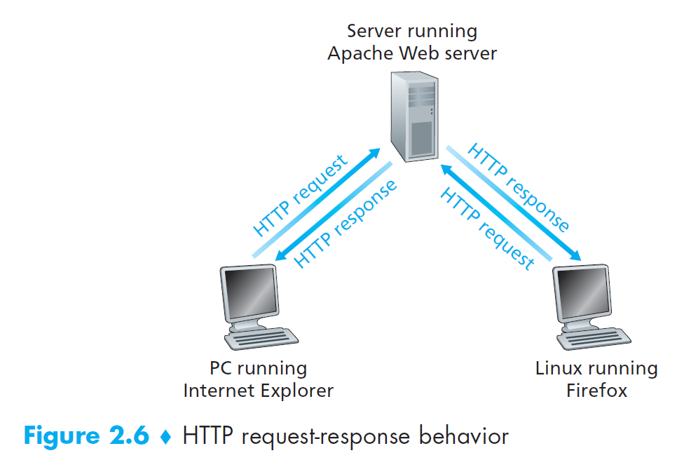
Web Browsers – clients
Web Servers – Servers
HTTP defines how Web clients request Web pages from Web servers and how servers transfer Web pages to clients.
HTTP uses TCP as its underlying transport protocol (rather than running on top of UDP).
HTTP is a stateless protocol as it does not store information about the client.
Notes:
The HTTP client first initiates a TCP connection with the server. Once the connection is established, the browser and the server processes access TCP through their socket interfaces.
It is important to note that the server sends requested files to clients without storing
any state information about the client. If a particular client asks for the same object
twice in a period of a few seconds, the server does not respond by saying that it just
served the object to the client; instead, the server resends the object, as it has completely
forgotten what it did earlier. Because an HTTP server maintains no information
about the clients, HTTP is said to be a stateless protocol.

Slide 33
Persistent and non persistent connections
HTTP, which can use both non-persistent connections and persistent connections. Although HTTP uses persistent connections in its default mode, HTTP clients and servers can be configured to use non-persistent connections instead.
Non- persistent: each request/response sent over a separate connection.
Persistent: All requests/responses sent over the same connection
Notes:
In many Internet applications, the client and server communicate for an extended
period of time, with the client making a series of requests and the server responding to
each of the requests. Depending on the application and on how the application is being
used, the series of requests may be made back-to-back, periodically at regular intervals,
or intermittently. When this client-server interaction is taking place over TCP, the application
developer needs to make an important decision––should each request/response
pair be sent over a separate TCP connection, or should all of the requests and their corresponding
responses be sent over the same TCP connection? In the former approach,
the application is said to use non-persistent connections; and in the latter approach,
persistent connections.

Slide 34
HTTP & HTML
A web address or uniform resource locator (URL) is a reference to a web server.
A URL allows a web browser to establish a connection to that web server.
URLs and Uniform Resource Identifier (URIs) are the names most people associate with web addresses.
The URL http://cisco.com/index.html has three basic parts:
o http (the protocol or scheme)
o www.cisco.com (the server name)
o index.html (the specific filename requested)
Using DNS, the server name portion of the URL is then translated to the associated IP address before the server can be contacted.
Notes:
Hypertext Transfer Protocol and Hypertext Markup Language

Slide 35
The browser sends a GET request to the server’s IP address and asks for the index.html file.
The server sends the requested file to the client.
The index.html was specified in the URL and contains the HTML code for this web page.
The browser processes the HTML code and formats the page for the browser window based on the code in the file.

Slide 36
HTTP & HTTPS
HTTP
o Is a request/response protocol.
o Has three common message types: GET, POST, PUT.
o Is not secure. Messages can be intercepted.
o port 80
Protocol://servername:port/path
HTTPS
o uses authentication and encryption to secure data.
o port 443
Notes:
Persistent and non persistent, proxy, http protocol structure, SSL secure Socket Layer

Slide 37
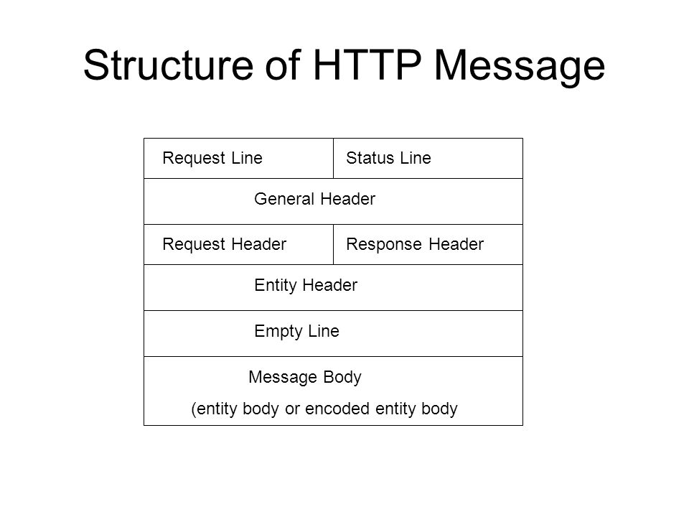

Slide 38
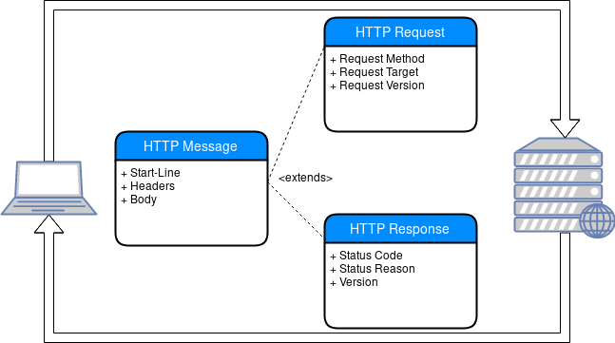

Slide 39
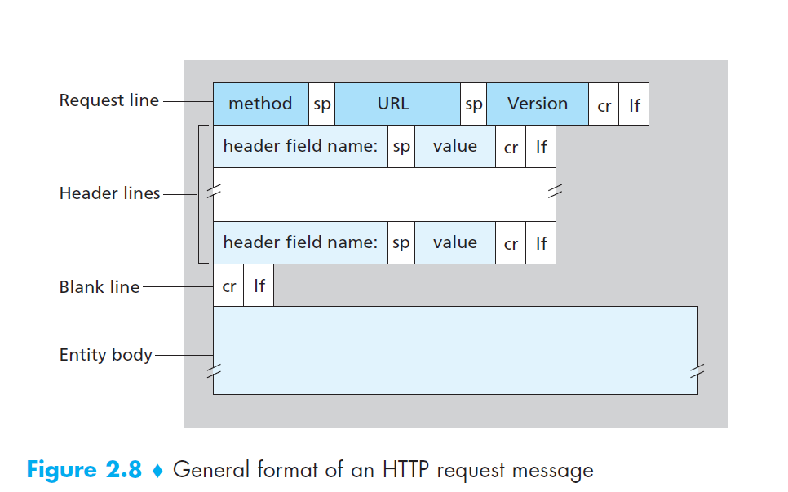
HTTP Request Header
Below we provide a typical HTTP request message:
GET /somedir/page.html HTTP/1.1
Host: www.someschool.edu
Connection: close
User-agent: Mozilla/5.0
Accept-language: fr
Notes:
By including the Connection:
close header line, the browser is telling the server that it doesn’t want to bother
with persistent connections; it wants the server to close the connection after sending
the requested object. The User-agent: header line specifies the user agent, that
is, the browser type that is making the request to the server. Here the user agent is
Mozilla/5.0, a Firefox browser. This header line is useful because the server can
actually send different versions of the same object to different types of user agents.

Slide 40
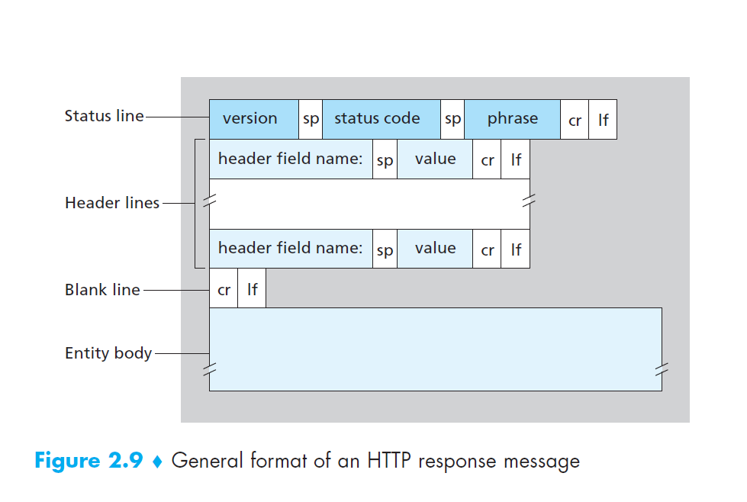
HTTP Response Header
HTTP/1.1 200 OK
Connection: close
Date: Tue, 09 Aug 2011 15:44:04 GMT
Server: Apache/2.2.3 (CentOS)
Last-Modified: Tue, 09 Aug 2011 15:11:03 GMT
Content-Length: 6821
Content-Type: text/html
(data data data data data ...)

Slide 42
References
https://www.computernetworkingnotes.com/networking-tutorials/network-cable-types-and-specifications.html
Data Communication and Computer Networks by Behrouz A Forouzan.pdf
Data And Computer Communications by William Stallings.pdf
https://www.academia.edu/37562829/INTRODUCTION_TO_COMPUTER_NETWORKS
https://www.studytonight.com/computer-networks/osi-model-network-layer#:~:text=Network%20Layer%20%2D%20OSI%20Model,across%20multiple%20links%20(networks).&text=It%20routes%20the%20signal%20through,acts%20as%20a%20network%20controller.
https://www.guru99.com/difference-tcp-ip-vs-osi-model.html#:~:text=OSI%20refers%20to%20Open%20Systems,both%20connection%2Doriented%20and%20connectionless.

